Slide 1
Algorithmic Mathematics Presentation
Laplace, Parabolic, Hyperbolic
Prepared by:
Rajesh Gautam

Slide 2
Contents
Laplace Equation
Parabolic Equation
Hyperbolic Equation

Slide 3
Laplace Equation
Laplace's equation is second-order partial differential equation.
∂^{₂}u/ ∂x^{₂} + ∂^{₂}u/∂y^{₂} = 0,
or ∇^{₂}u = 0
The Laplace equation is used to find 2D steady state(state which doesn’t change with respect to time) solution to the heat problem.

Slide 4
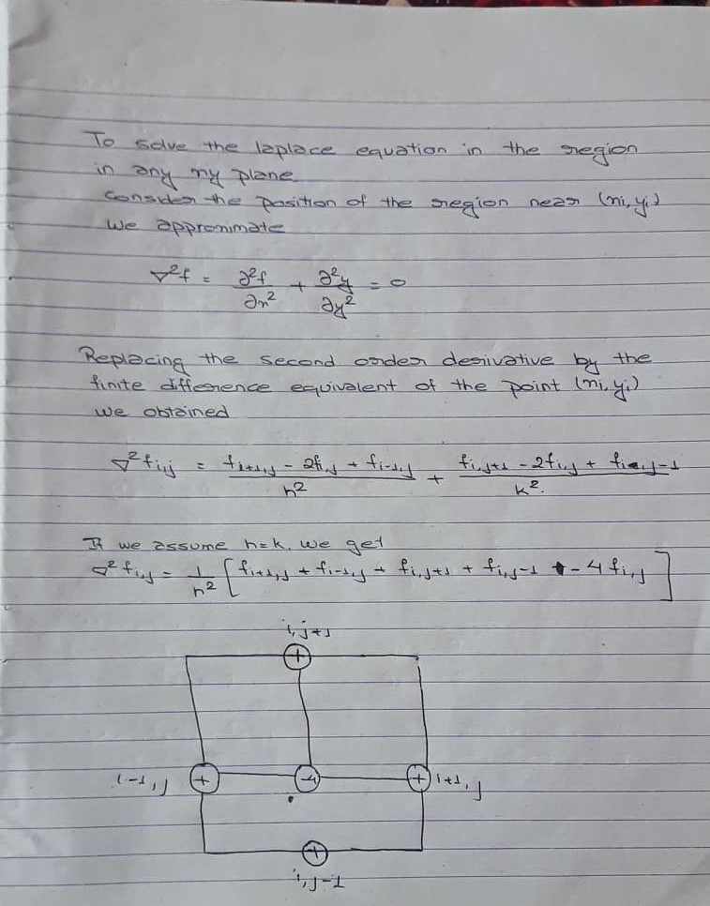

Slide 5
Parabolic Equation
Parabolic equations describe processes that are evolving in time. For such an equation the initial state of the system is part of the auxiliary data for a well-posed problem.
Parabolic equation for which b ^{₂} -4ac = 0 describe the problem that depend on space and time variables.

Slide 6
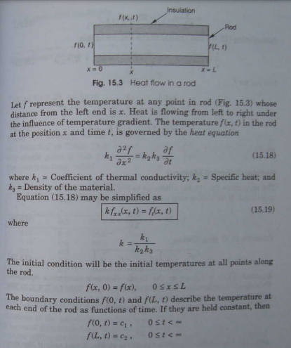

Slide 7
Hyperbolic Equation
Hyperbolic equations model the vibration of structures such as buildings , beams .
Let us consider the case of vibrating string that is fixed at both the e The lateral displacement of string f varies with time t and distance x along the string. The displacement f(x , t) is governed by the wave equation:
T(∂^{₂}f/ ∂x^{₂}) = p(∂^{₂}f/∂t^{₂})
T = tension and p = mass per unit length

Slide 8
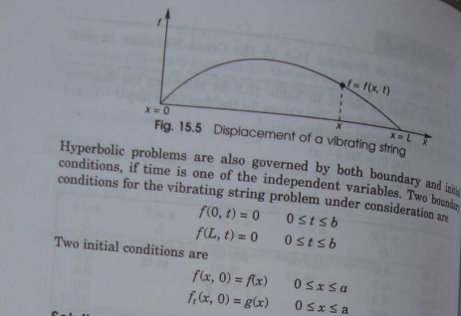

Slide 9
THANK YOU

